Slide 1








Object detection car and Bluetooth RC Car

Slide 2



Introduction
Object detection and bluetooth control have made substantial strides in recent years, playing a pivotal role in numerous applications, from autonomous vehicles and aerospace to security and environmental monitoring.

Slide 3



Project overview
This project tell us how to make a multi-functional robot using the Arduino platform. That is, this includes obstacle avoidance, Bluetooth control. Also, It mainly uses an Ultrasonic sensor and a Bluetooth module. The L293D motor drive shield is used to drive the motors.

Slide 4




Components Used

Slide 5


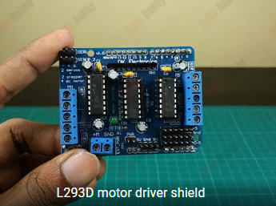
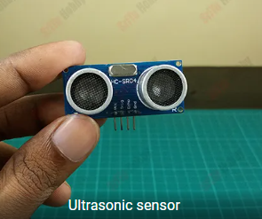
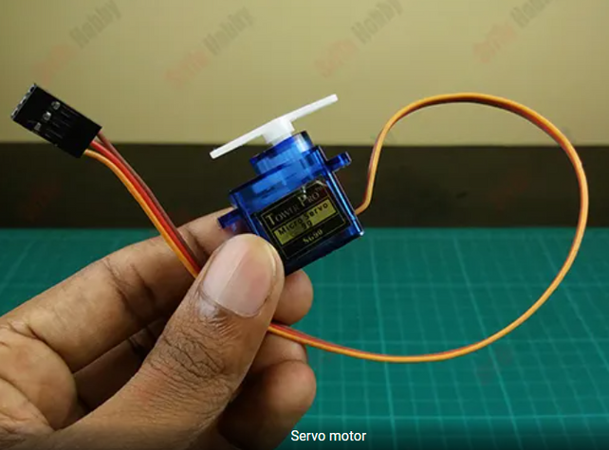
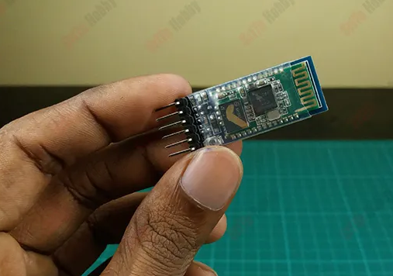
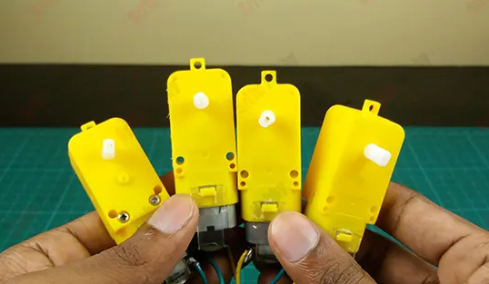
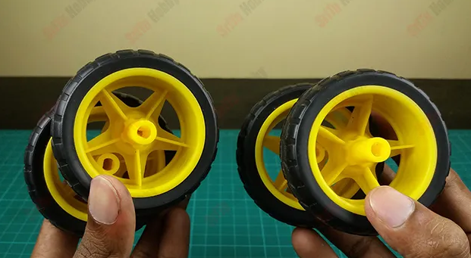
Components
1
2
3
4
5
6

Slide 6
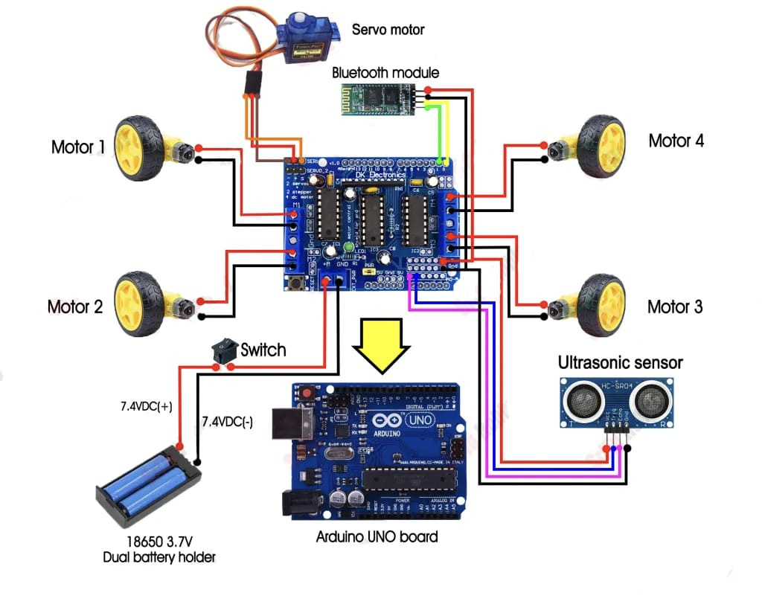
Block Diagram

Slide 7





Applications
Gesture Control: Arduino can be used in combination with object detection to enable gesture-based control of various car functions, such as adjusting the volume, changing radio stations, or answering calls.
Automated Parking: Arduino can be used to create systems that allow a car to autonomously navigate and park in a parking lot, improving parking efficiency.
Driver Monitoring: Arduino-based object detection can be used to monitor the driver's attention and alertness. If the system detects signs of drowsiness or distraction, it can issue warnings.
Adaptive Cruise Control: Object detection can be integrated with adaptive cruise control systems to automatically adjust the car's speed based on the distance to the vehicle in front. Arduino can help process data from sensors and control the throttle and brakes.

Slide 8


THANK YOU

